Slide 1
PEARL & Positional Encodings in Graph Neural Networks
Student: Fabio Massimo Ercoli
Code: 802397
Course: Neural Networks

Slide 2
Outline
1. Graph Isomorphism Networks (GIN)
2. Positional Econding: LSPE, SignNet, BasisNet, SPE
3. Positional Econding: R-PEARL, B-PEARL
4. PEARL: Implementation Overview
5. Results and Conclusions

Slide 3
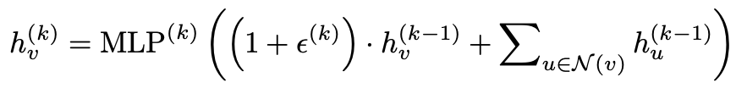
Graph Isomorphism Network
MP- GNN
Graph Neural Networks (GNNs) are an effective framework for representation
learning of graphs.
MP- GNN
GNNs follow a neighborhood aggregation scheme, where the
representation vector of a node is computed by recursively aggregating and trans-
forming representation vectors of its neighboring nodes.
MP- GNN
GIN
its discriminative/representational power is equal to the power of the Weisfeiler Leman test

Slide 4
Positional Encoding for GNN
A major issue with arbitrary graphs is the absence of canonical positional information of nodes. (pixels in images, words in texts and nodes in graph)
Learning positional representation that can be combined with structural GNNs to generate more expressive node embedding. Makes nodes more distinguishable. Adds global structural information.
Permutation-invariant if you consider each single node
Permutation-equivariant if you consider an ordered list of nodes
Distance-sensitive the difference between the PEs of two nodes far apart on the graph must be large, and small for two nodes nearby
Laplacian Eigenvectors (Dwivedi et al., 2020; Dwivedi & Bresson, 2021)

Slide 5
Positional Econding for GNN
1
2
3
4
LSPE
SignNet / BasisNet
SPE
PEARL
Learnable Structural and Positional Encodings
Paper: Graph Neural Networks with Learnable Structural and Positional Representations (Dwivedi et al., 2022)
Sign / Basis Invariant Sign Invariant Networks
Paper: Sign and Basis Invariant Networks for Spectral Graph Representation Learning (Derek Lim, Joshua Robinson, et al., 2022)
Stable and Expressive Positional Encodings
Paper: On the Stability of Expressive Positional Encodings for Graphs (Huang et al, 2024)
Positional Encodings Augmented with Representation Learning
Paper: Learning Efficient Positional Encodings with Graph Neural Networks (Kanatsoulis et al., 2025)

Slide 6
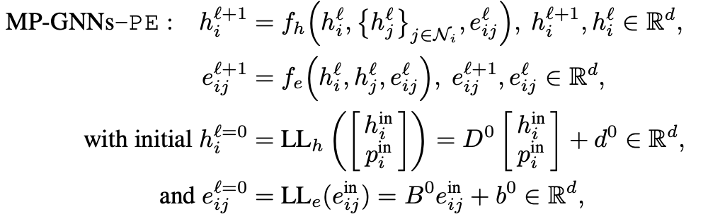
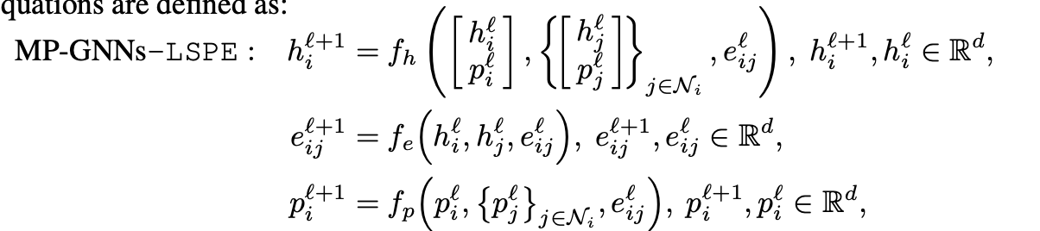
LSPE: decoupling position and structure

Slide 7

Laplacian Eigenvectors PE
Random Walk PE
Positional Encoding
Sign ambiguity as eigenvectors are defined up to ±1. This leads to 2^{k} number of possible sign values when selecting k number of eigenvectors. No sign-invariance
If an eigenvalue has an algebraic multiplicity greater than one, its corresponding eigenspace can have a dimension greater than one, which means you can choose different sets of linearly independent eigenvectors (bases) for that same eigenvalue. No basis-invariance
Diffusion process
RWPE provide a unique node representation under the condition that each node has a unique k-hop topological neighborhood for a sufficient large k
Iterating the random walk operator for a suitable number of steps allows coloring non-isomorphic nodes, thus distinguishing several cases of non-isomorphic graphs on which the 1-WL test
L = I_{n}−D^{−1/2}AD^{−1/2} = U^{T}ΛU
Spectral decomposition of the normalized laplacian
Laplacian eigenvectors of a graph capture clusters,
subgraph frequencies, connectivity, and many
other useful properties.
RW= AD⁻¹
A: adjacency matrix
D: degree matrix
Laplacian Eigenvectors (Dwivedi et al., 2020; Dwivedi & Bresson, 2021)
Graph Neural Networks with Learnable Structural and Positional Representations (Dwivedi et al., 2022)

Slide 8


SignNet PE
BasisNet PE
Positional Encoding
Sign invariance is a special case of basis invariance when all eigenvalues are distinct.
f(v₁, …, v_{k}) = f(s₁v₁, …, s_{k}v_{k}) s_{i} ∈{−1,1}
For one subspace, a sign invariant function is merely an even function:
h(v) = φ(v) + φ(−v)
64% of molecule graphs in the ZINC dataset have a higher dimensional eigenspace.
V₁ , ..., V_{l} be bases of eigenspaces
V₁Q₁, …, V_{l}Q_{l} any other bases for some Q₁, …, Q_{l} Q∈O(d)
f(V₁, ..., V_{l}) = f(V₁Q₁, ..., V_{l}Q_{l})
Any continuous O(d) invariant h is of the form:
h(V) = φ(VV⊤)
f(v₁, ..., v_{k}, λ₁, ..., λ_{k}, X) =
Sign and Basis Invariant Networks for Spectral Graph Representation Learning (Derek Lim, Joshua Robinson, et al., 2022)
Using invariant graph network as ɸ

Slide 9
SignNet/BasisNet
Compute Laplacian eigenvectors V
L = I_{n}−D^{−1/2}AD^{−1/2} = U^{T}ΛU
Process through SignNet/BasisNet
PE = SignNet(U) or BasisNet(U)
Concatenate with node features
X_augmented = [X, PE]
Feed to base GNN
Expressive
Provably approximates many existing PE methods
Captures clusters, subgraph frequencies, connectivity
Not Stable
Hard partitioning of eigenspaces: each eigenspace is an independent silos (independent network)
Small perturbations in Laplacian → large PE changes
Discontinuous at degeneracy points (when eigenvalues are close)
Stability proven to be crucial for Generalization

Slide 10
SPE: Stable & Expressive Positional Encodings
Soft and learnable “partition” of eigen subspaces in a eigenvalue dependent way. Instead of treating each eigen subspace independently, we apply a weighted sum of eigenvectors in an eigenvalue-dependent way.
SPE(V, λ) = ρ(V diag(φ₁(λ)) V^{T}, ..., V diag(φₘ(λ)) V^{T})
Universally approximates basis-invariant functions.
Trade-off: High Stability ⟺ Lower Expressiveness
Better Generalization for instance reducing the generalization gap between MAE train - MAE test in our ZINC dataset
On the Stability of Expressive Positional Encodings for Graphs (Huang et al, 2024)

Slide 11
PEARL: Positional Encodings Augmented with Representation Learning
GSO graph shift operator: the adjacency matrix, the Laplacian matrix, their normalized variants, or the RW transition. typically sparse
Full eigenvector approaches COMPUTE eigenvectors of some GSO:
Computational complexity: O(N³)
Memory intensive for large graphs
Don’t COMPUTE but…
LEARN a nonlinear function of GSO eigenvectors.
Scalability Computational complexity: O(N²) / O(N)
Expressivity of Full Eigenvector Approaches: strictly more powerful than the 1-FWL test. It count the number of 3-, 4-, 5-, 6-, and 7-node cycles in which each node participates, for any given graph.
Stability comes for free: we don’t need soft partitioning tricks – like in SPE
achieving up to a 6% improvement on graph classification tasks
Learning Efficient Positional Encodings with Graph Neural Networks (Kanatsoulis et al., 2025)

Slide 12
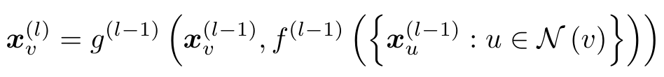
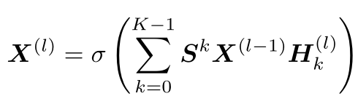

PEARL: Positional Encodings Augmented with Representation Learning
GNN operates as a nonlinear function of the GSO eigenvectors:
AGGREGATE f({x_{u}}):
S represents the adjacency matrix, the Laplacian matrix, the normalized adjacency, the normalized Laplacian, and the Random Walk matrix.
X^{(l)}=g^{(l-1)}(X^{(l-1)},SX^{(l-1)}) : signals of all vertices at layer l
COMBINE g(x_{v},f({x_{u}})): an equivariant MLP operating on each node independently
H_{k}: trainable parameter of MLP. Higher values of K can be considered for more generalized GNN layers
The filter (allowing k > 2) is applied only once. After that, each GINLayer implicitly applies a k=2 polynomial structure (combining self and 1-hop neighbor features), though using adjacency-based aggregation as GSO in the
recursive message-passing operations

Slide 13
PEARL
Choice of node attributes
Expressiveness
Initializing each node with a set of M unique identifiers {q_{v}⁽¹⁾, …, q_{v}^{(M)}}
Set of M independent initial node attributes {q^{(m)} }, m ∈ [1,M], q^{(m)} ∈ R^{N}
Each G, q (m) is independently processed via a mpGNN Φ(·)
P^{(m)} = Φ(G, q^{(m)}) ∈ R^{N x d}
Permutation Equivariance
Statistical pooling functions ρ
P(m) = ρ[Φ(G, q⁽¹⁾), …, Φ(G, q^{(M)})]
Basis Universality
For any continuous basis-invariant function f(V) = f(VQ), for any Q ∈ O(λ), S = VΛV^{T}
=>∃ GNN Φ and equivariant function ρ :
f(V) = ρ[Φ(G, q⁽¹⁾), …, Φ(G, q^{(M)})]

Slide 14
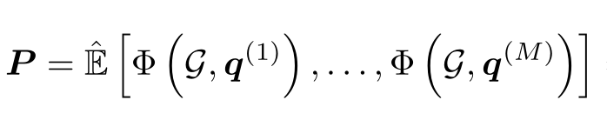

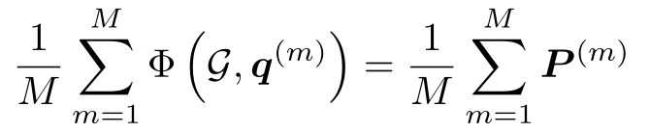
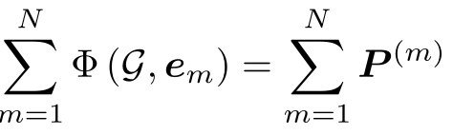
B-PEARL
R-PEARL
Positional Encoding
Θ(M·N·F² + M·|E|·F)
Θ(N²·F² + N·|E|·F)
Node attributes {q^{(m)} } independent and identically distributed random variables
Φ(G, q^{(m)}) is itself permutation equivariant
ρ Mean: favorable convergence, stability properties and simplicity
Ideal for large graph, M << N, O(N)
For small graph, M ~ N, O(N²)
Standard basis vectors {e_{m}}
e_{m}[m] = 1 and e_{m}[i ̸= m] = 0
Φ(G, q^{(m)}) not itself permutation equivariant
ρ Sum: permutation equivariant
Ideal for small graph, same O(N²) but with better performance

Slide 15
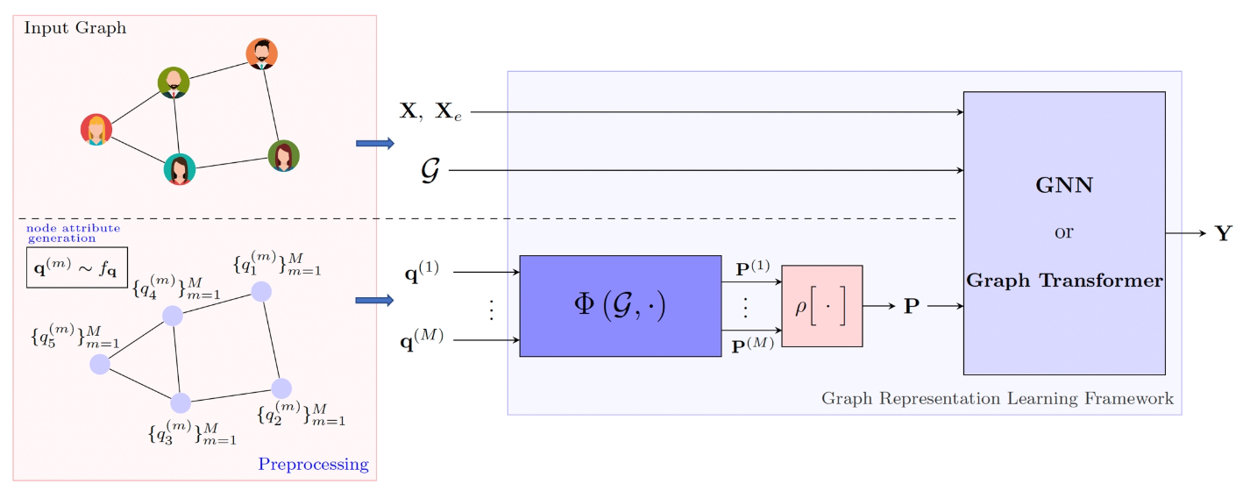
Main Model
class PEARL_GNN_Model(nn.Module):
node_features: nn.Embedding
positional_encoding: PEARLPositionalEncoder
pe_embedding: nn.Linear
base_model: GINEBaseModel
def __init__(self, mf: ModelFactory):
super(PEARL_GNN_Model, self).__init__()
self.node_features = nn.Embedding(mf.hp.n_node_types, mf.hp.node_emb_dims)
self.positional_encoding = PEARLPositionalEncoder(mf)
self.pe_embedding = nn.Linear(self.positional_encoding.out_dims, mf.hp.node_emb_dims)
self.base_model = GINEBaseModel(mf)
def forward(self, batch: Batch) -> torch.Tensor:
X_n = self.node_features(batch.x.squeeze(dim=1))
PE = self.positional_encoding(batch)
X_n = X_n + self.pe_embedding(PE)
return self.base_model(X_n, batch.edge_index, batch.edge_attr, PE, batch.batch)

Slide 16
My Experiment
DataSet: PTG ZINC
Optimizer: Adam
Scheduler: LambdaLR
Loss: MAE
Model selection: Best Val
#(node types): 28
#(n_edge_types): 3
Node emb dim: 128
Dropout prob: 0.0
Normaliz: Batch
GINE layers: 4
Sample Agg. Layers: 8
Sample Agg. Hdim: 40
Device: AMD Radeon RX 7800 XT
GSO: Normalized Laplacian
Learning Rate: 10⁻³
Weight Decay: 10⁻⁶
#(epochs): 67 240
#(warm up steps): 100
Model selection: Best Val
Batch size: 32
R-PEARL B-PEARL
PEARL K: 7
#(samples): 120
#(params): 644,241
PE dim: 37
PEARL MPL Layers: 1
PEARL MPL Hdim: 37
PEARL MLP out: 37
Seed: 42
Same hyperparameters of the Paper code base - with few #(epochs)

Slide 17
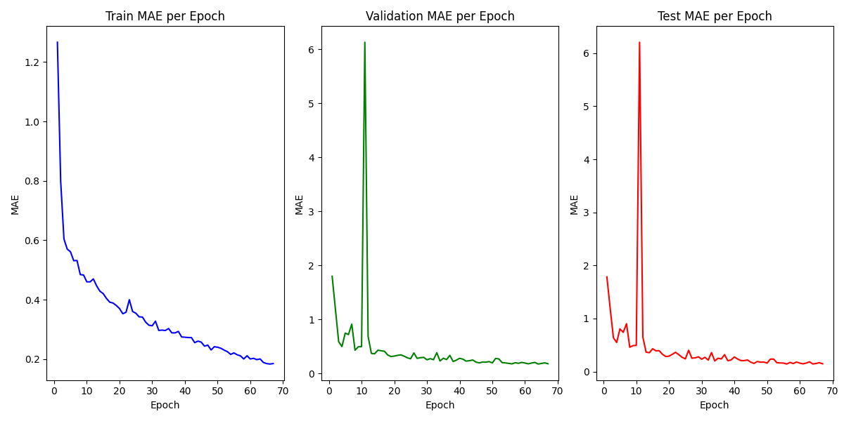
R-PEARL
# epochs: 67
# M:
120
Test MAE:
0.1443

Slide 18
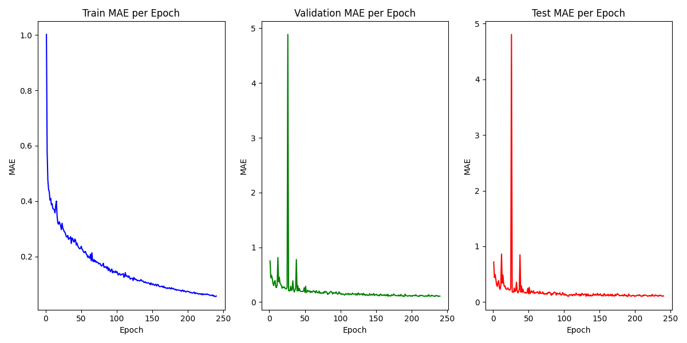
B-PEARL
# epochs: 240
Test MAE: 0.0981

Slide 19
Thank you!
Student: Fabio Massimo Ercoli
Code: 802397
Course: Neural Networks

